Slide 1

CSE 467
Chapter 2
Instruction Sets

Slide 2
Introduction
Instruction sets are one of the first topic when one is studying microprocessors
Instruction sets are programmer’s interface to the hardware (microprocessors, memory, various I/Os)
Instruction sets are defined by assembly language
Instruction sets are key tools of analysis of performance of programs – high-level languages which dominate today’s embedded computing systems’ designs are analyzed using very low-level languages (microprocessors’ assembly languages)

Slide 3
Introduction
Assembly language instructions sets are different for every microprocessor but they can be very similar for some families of microprocessors
In this class we will introduce four different CPUs or microprocessors examples and their instruction sets assembly languages
Four CPUs’ computer architectures and instruction sets which we will study in this class are:
  PIC16F from Microchip Technology
  ARM processors (widely used in cell phones & in many other systems)
  C55x Digital Signal Processor (DSP) family from Texas Instruments
  C64x Digital Signal Processor (DSP) family from Texas Instruments

Slide 4
CPU’s Computer Architecture
The computing system has two parts:
  Central processing unit (CPU)
  Memory
The memory holds data and instructions and can be read or written when given an address
The CPU has several internal registers that store values that are used internally
One of CPU’s internal registers is the program counter (PC) which holds the address in memory of next instruction to be executed

Slide 5
CPU’s Computer Architecture
The CPU does the following:
  It fetches the instruction from memory location which address is being held in the PC
  It decodes the instruction
  It executes the instruction
  PC is incremented to an address in memory when the next instruction is stored and getting ready to be fetched, decoded and executed by the CPU
There are two types of computer architectures which have different memory organizations:
  Von Neumann Computer Architecture
  Harvard Computer Architecture

Slide 6
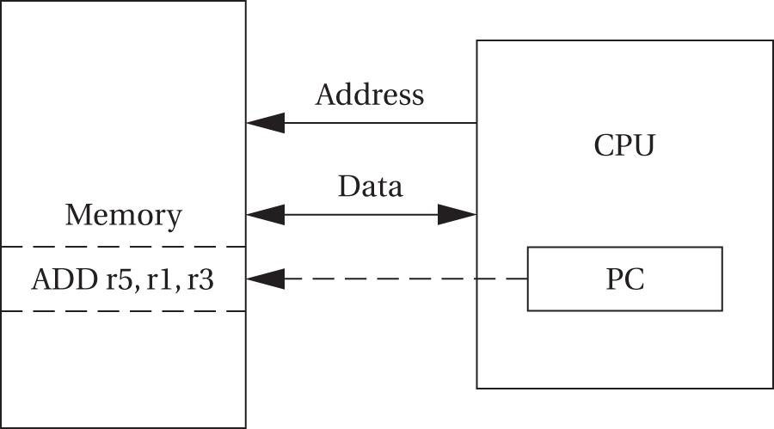
Von Neumann Computer
Architecture
A von Neumann architecture computer is shown below

Slide 7
Von Neumann Computer
Architecture
A von Neumann architecture computer has memory that holds both data and instructions

Slide 8
Von Neumann Computer
Architecture
PC does not decide what machine does next
PC only indirectly points to instruction in memory
By changing the instructions only, we can change what CPU does next

Slide 9
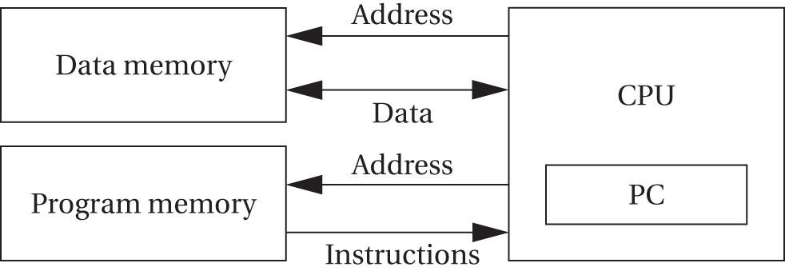
Harvard Computer Architecture
A Harvard architecture is shown below

Slide 10
Harvard Computer Architecture
A Harvard architecture separates data memory and instruction memory

Slide 11
Harvard Computer Architecture
A Harvard architecture is most widely used computer architecture in modern computer systems
By separating data memory and instruction memory we use two separate ports when accessing memory which provides higher memory bandwidth (e.g. DSPs – Digital Signal Processors)
In this way data and instructions memories do not compete for the access to the same port
In this way large data sets can be moved at the proper times

Slide 12
CISC vs RISC
Another way to distinguish different computer architectures is their relationship to their instructions and how they execute them
According to this model there are two types of computer architectures:
  Complex instruction set computers (CISC)
  Reduced instruction set computers (RISC)
CISC machines represented many early computer machines
CISC machines can perform long, complex instructions of different formats and different lengths

Slide 13
CISC vs RISC
RISC machines are widely used today and these computer machines are used in design of high-performance microprocessors
RISC machines have fewer and simpler instruction sets
RISC machines use load/store instruction sets
RISC machines cannot perform operations directly on memory location, only on registers
The pipelined processors benefit from RISC machines design because their instruction sets are very efficient
RISC machines outperformed CISC machines and they are dominating modern microprocessor designs

Slide 14
Instruction Sets features
Instruction sets basically represent the interface between software modules of the system and underlying hardware of the system
Instruction sets define what the hardware will do under certain circumstances
Instructions sets have a variety of features such as:
  Fixed versus variable length
  Addressing modes
  Number of operands
  Types of operations supported

Slide 15
World Length
Computer Architectures are very much defined by their world length which can be:
  4-bit
  8-bit
  16-bit
  32-bit and so on
That is definition for example of 8-bit microprocessor, 16-bit microprocessor, 32-bit microprocessor etc.
Some computers have the same length of a data word, an instruction, and an address

Slide 16
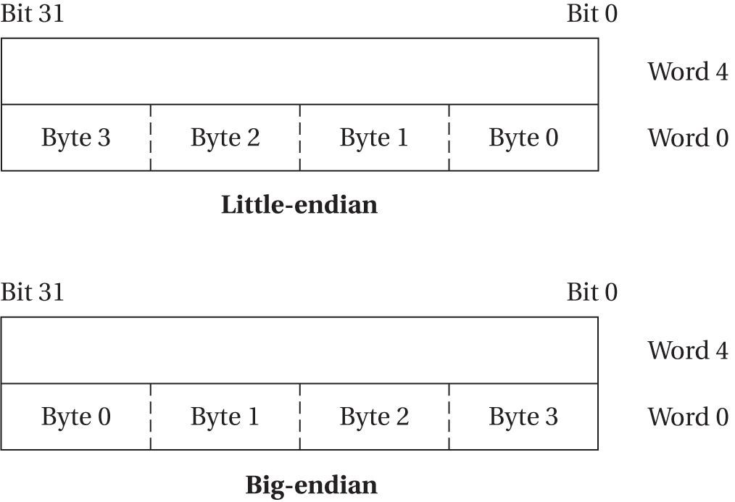
Big-endian vs Little-endian
Another important characteristic of computer architectures is their way of numbering bits, bytes and words
This is very important when we design program execution
There are two types of numbering in computer architectures:
  little-endian mode – lowest-order byte residing in the low-order bits of the word
  big-endian mode – lowest-order byte residing in the highest-order bits of the word

Slide 17
Instruction execution
Computer architectures are also designed for different types of instruction execution
Based on this design feature there are:
  Single-issue processors – execute one instruction at a time. They can have several instructions being at different stages of execution but only one instruction can be at any particular stage of execution.
  PowerPC processors are well known single-issue processors.
  Multiple-issue processors – allow multiple instructions executions at a time. Various Motorola processors, IBM processors, Sun Microsystems processors and Intel earlier processors are well known multi-issue processors

Slide 18
Instruction execution
  Superscalar processors – use specialized logic to identify at run time instructions that can be executed at the same time. They are requiring a lot of energy and they are not much used for embedded systems processor designs. Intel Pentium family of processors is well known superscalar processor family.
  Very Long Instruction Words processors – rely on the compiler to determine what combination of instructions can be legally executed together. VLIW are often used in high-performance embedded computing systems. ATI Technologies' (ATI) and Advanced Micro Devices’ (AMD) TeraScale microarchitecture for graphics processing units (GPUs) is a well-known type of VLIW microarchitecture.

Slide 19
CPUs and Systems
A set of registers available for use by programs are called programming model
All CPUs have many other registers that are used for some internal operations and they are not available to the programmers
A CPU is a part of any embedded system together with memory, bus and various I/O devices which all can be separate IC (integrated chips)
A processor IC san be defined as:
  microprocessors which means single-chip computer that includes a processor, bus, memory and I/O devices. Microcontroller is usually defined as a single chip with small CPU and also includes some read-only memory for program storage
  System-on-chip generally refers to a larger processor that includes some on-chip RAM that is usually supplemented by an off-chip memory

Slide 20
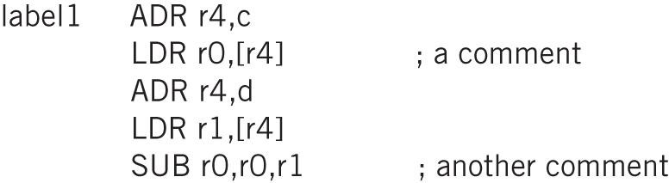
Assembly Languages
Instruction sets for any processor are used to write Assembly language programs that are executed on the processor hardware
Assembly languages code example for ARM processor is shown below

Slide 21
Assembly Languages
Instruction sets for any processor are used to write Assembly language programs that are executed on the processor hardware
Assembly languages code example for ARM processor is shown below
One instruction per line

Slide 22
Assembly Languages
Instruction sets for any processor are used to write Assembly language programs that are executed on the processor hardware
Assembly languages code example for ARM processor is shown below
Label gives
name to
memory location

Slide 23
Assembly Languages
Instruction sets for any processor are used to write Assembly language programs that are executed on the processor hardware
Assembly languages code example for ARM processor is shown below
Helpful Comment

Slide 24
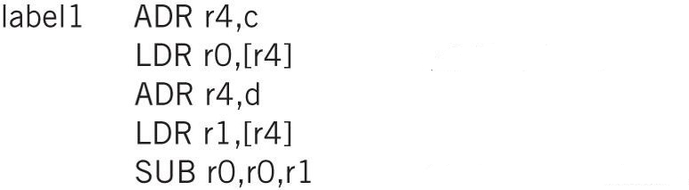
Assembly Languages
Instruction sets for any processor are used to write Assembly language programs that are executed on the processor hardware
Assembly languages code example for ARM processor is shown below
; set register r4 to address value c

Slide 25
Assembly Languages
Instruction sets for any processor are used to write Assembly language programs that are executed on the processor hardware
Assembly languages code example for ARM processor is shown below
; set register r4 to address value c
; load register r0 with the value of
; memory address location c

Slide 26
Assembly Languages
Instruction sets for any processor are used to write Assembly language programs that are executed on the processor hardware
Assembly languages code example for ARM processor is shown below
; set register r4 to address value c
; load register r0 with the value of
; memory address location c
; set register r4 to address value d

Slide 27
Assembly Languages
Instruction sets for any processor are used to write Assembly language programs that are executed on the processor hardware
Assembly languages code example for ARM processor is shown below
; set register r4 to address value c
; load register r0 with the value of
; memory address location c
; set register r4 to address value d
; load register r1 with the value of
; memory address location d

Slide 28
Assembly Languages
Instruction sets for any processor are used to write Assembly language programs that are executed on the processor hardware
Assembly languages code example for ARM processor is shown below
; set register r4 to address value c
; load register r0 with the value of
; memory address location c
; set register r4 to address value d
; load register r1 with the value of
; memory address location d
; subtract r0 – r1 and store it to r0

Slide 29
Assembly Languages
Instruction sets for any processor are used to write Assembly language programs that are executed on the processor hardware
Assembly languages code example for ARM processor is shown below
; set register r4 to address value c
; load register r0 with the value of
; memory address location c
; set register r4 to address value d
; load register r1 with the value of
; memory address location d
; subtract r0 – r1 and store it to r0
The assembler parses the assembly language programs using these simple structures and the assembler is accessing assembly language programs line by line.

Slide 30
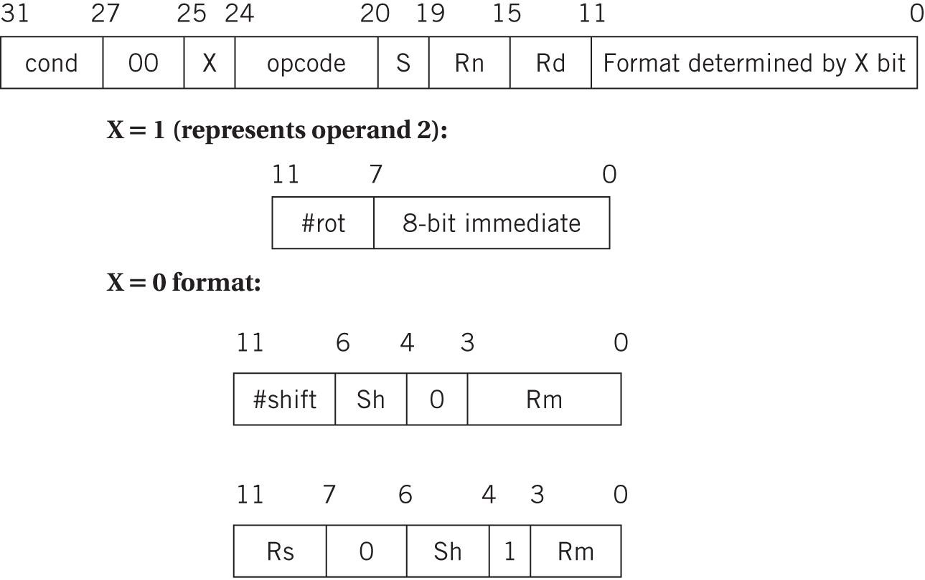
Assembly Languages
The format of ARM processor data instruction ADD is shown below

Slide 31
Assembly Languages
For example the instruction ADDGT r0, r3, #5 would be decoded as shown below

Slide 32
Assembly Languages
For example the instruction ADDGT r0, r3, #5 would be decoded as shown below
cond = 1100
because that
is GT condition code

Slide 33
Assembly Languages
For example the instruction ADDGT r0, r3, #5 would be decoded as shown below
opcode = 0100
because that
is ADD binary code
cond = 1100
because that
is GT condition code

Slide 34
Assembly Languages
For example the instruction ADDGT r0, r3, #5 would be decoded as shown below
Rn = r3
opcode = 0100
because that
is ADD binary code
cond = 1100
because that
is GT condition code

Slide 35
Assembly Languages
For example the instruction ADDGT r0, r3, #5 would be decoded as shown below
Rn = r3
Rd = r0
opcode = 0100
because that
is ADD binary code
cond = 1100
because that
is GT condition code

Slide 36
Assembly Languages
For example the instruction ADDGT r0, r3, #5 would be decoded as shown below
Rn = r3
Rd = r0
operand2 = 5
opcode = 0100
because that
is ADD binary code
cond = 1100
because that
is GT condition code

Slide 37
VLIW processors
If processors can execute more than one instruction at the same time the programs can be executed faster – parallelizing of instruction execution
Superscalar processors scan programs during execution to find sets of instructions that can be executed together – predominantly used in general purpose computing systems
Very Long Instruction Word (VLIW) processors are used in embedded computing systems, mostly in DSP (Digital signal processing) processor embedded systems – rely on compilers to identify sets of instructions that can be executed together
Superscalar processors can find more parallelism of instruction execution than VLIW processors can, but that is much more costly in price and energy consumption

Slide 38
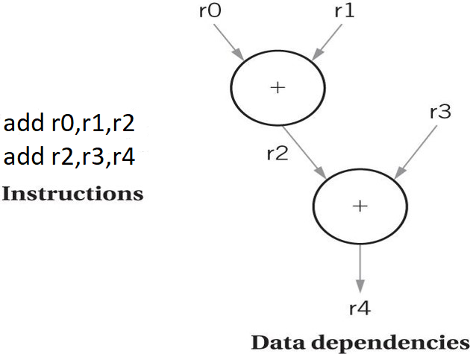
VLIW processors
To understand parallel instruction execution we need to understand data dependency which represents relationship between the data operated on by instruction
Data dependencies and order of instruction execution example is shown below

Slide 39
VLIW processors
To understand parallel instruction execution we need to understand data dependency which represents relationship between the data operated on by instruction
Data dependencies and order of instruction execution example is shown below
first we write to the register r2

Slide 40
VLIW processors
To understand parallel instruction execution we need to understand data dependency which represents relationship between the data operated on by instruction
Data dependencies and order of instruction execution example is shown below
second we read from the register r2

Slide 41
VLIW processors
To understand parallel instruction execution we need to understand data dependency which represents relationship between the data operated on by instruction
Data dependencies and order of instruction execution example is shown below
First instruction has to be executed before the second instruction!

Slide 42
VLIW processors
Branches also introduce control dependencies which can slow down execution, for example
bnz r3, foo
add r0, r1, r2
foo: …
Opportunities for parallelism arise because there are many combinations of instructions that do not introduce data or control dependencies and therefore, they can be executed in parallel
Good example of instruction parallel execution without data dependencies is shown in the next example

Slide 43
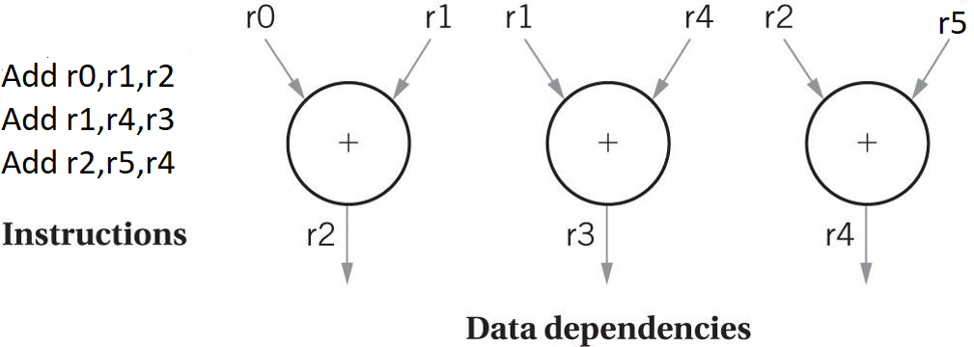
VLIW processors

Slide 44
VLIW vs Superscalar processors
VLIW processors examine dependencies between instructions within a packet of instructions and rely on the compiler to determine group of instructions within the packet that can be executed in parallel without any dependencies
Superscalar processors in contrast use hardware to analyze witch instructions can be executed in parallel without any dependencies
Due to the fact that VLIW processors do not have to analyze data dependencies at run time (compiler), VLIW processors are smaller and consume less power than superscalar processors
VLIW processors (e.g. DSPs) are very well suited embedded signal processing and multimedia applications such as cell phones

Slide 45
Microchip’s PIC16F microprocessor family

Slide 46
PIC16F microprocessor family
PIC16F family has Harvard architecture with separate data and instruction memory
Instruction memory can be up to 8192 words for this family
Instruction word is 14 bits long
Data memory is byte-addressable
Data memory may have up to 368 bytes in static random-access memory (SRAM) and up to 256 bytes in electrically erasable programmable read-only memory (EEPROM)

Slide 47
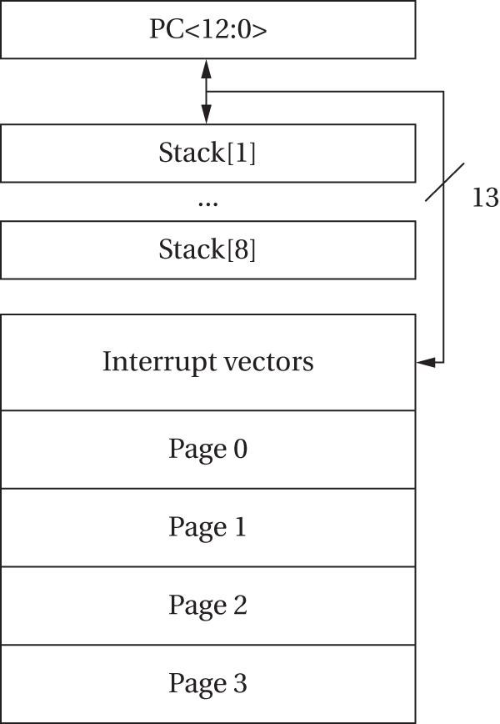
PIC16F microprocessor family
Instruction space for the PIC16F is shown below:

Slide 48
PIC16F microprocessor family
Instruction space for the PIC16F is shown below:
13 bit program counter: PCL register shadows PC<7:0>
PCLATH register shadows PC<12:8>

Slide 49
PIC16F microprocessor family
Instruction space for the PIC16F is shown below:
8-level stack
for the PC
which is used
for subroutine
RETURN and CALL instructions

Slide 50
PIC16F microprocessor family
Instruction space for the PIC16F is shown below:
Interrupts

Slide 51
PIC16F microprocessor family
Instruction space for the PIC16F is shown below:
The rest of memory is divided into 4 pages

Slide 52
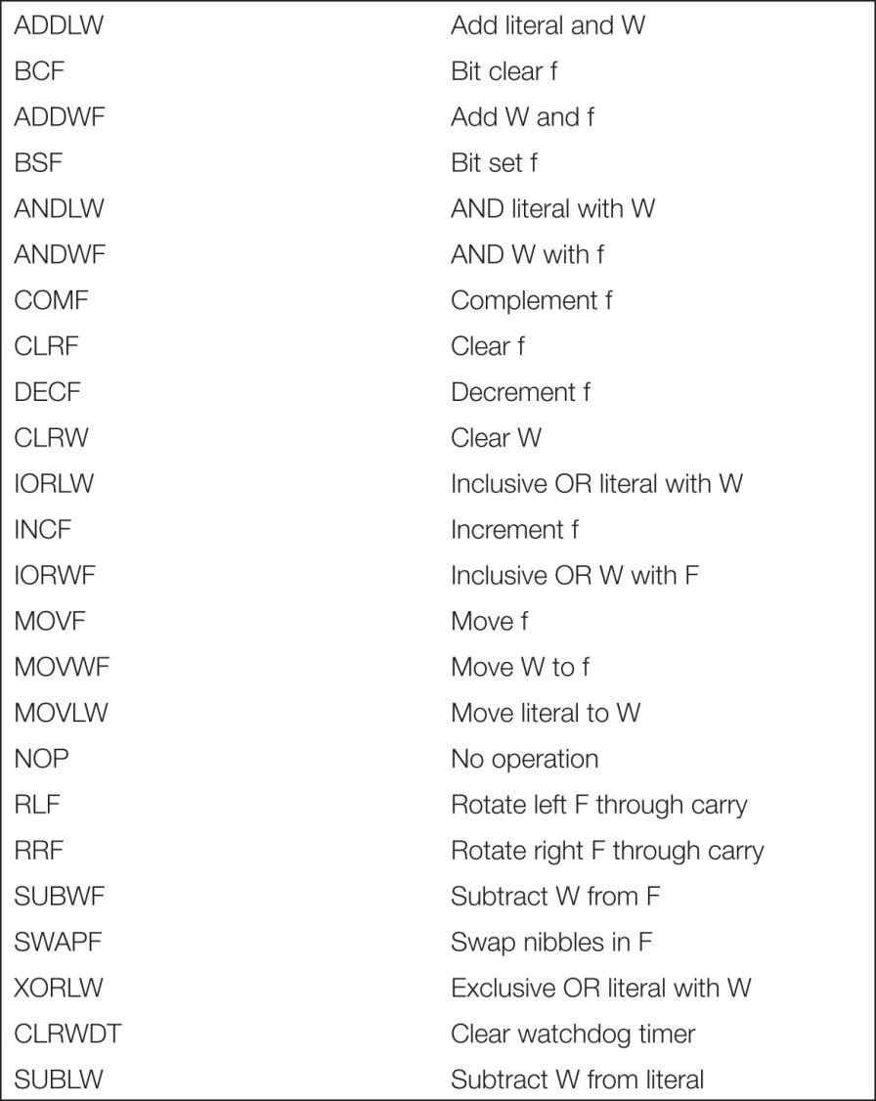
PIC16F microprocessor family
Data instructions in the PIC16F are shown below:

Slide 53
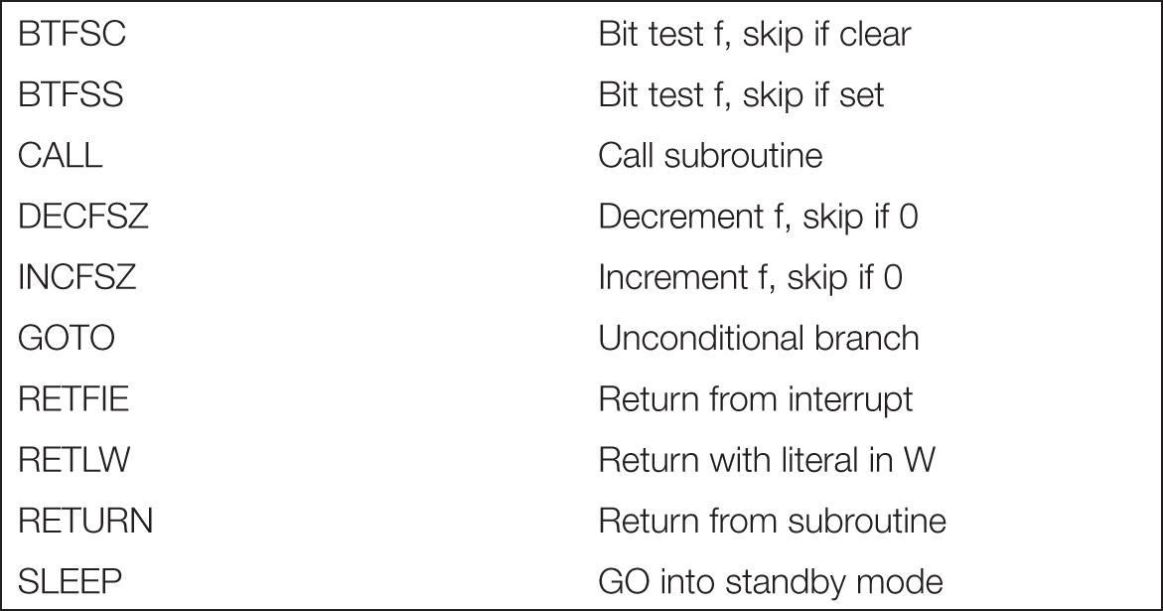
PIC16F microprocessor family
Flow of control instructions in the PIC16F are shown below:

Slide 54
Microchip’s PICXX microprocessor families
Microchip has different PIC families of microprocessors that have different complexity instructions sets
Microchip’s PIC families are:
  PIC16F microcontroller family (8-bit)
  PIC24 microcontroller family (16-bit)
  PIC32M microcontroller family (32-bit MIPS instruction set based family)
FIR filter design is a good example of assembly language code development for any processor family

Slide 55
FIR filter design for PIC family
FIR Filter design using PIC16 microcontrollers is a very good example of using instruction set to design the filter
Finite impulse response (FIR) filter is a filter whose impulse response (or response to any finite length input) is of finite duration, because it settles to zero in finite time
FIR filter of order N, each value of the output sequence is a weighted sum of the most recent input values:
y[n] = b₀x[n] + b₁x[n-1] + b₂x[n-2] + b₃x[n-3] + … +b_{N}x[n-N]

Slide 56
FIR filter design for PIC family
FIR Filter design using PIC16 microcontrollers is a very good example of using instruction set to design the filter
Finite impulse response (FIR) filter is a filter whose impulse response (or response to any finite length input) is of finite duration, because it settles to zero in finite time
FIR filter of order N, each value of the output sequence is a weighted sum of the most recent input values:
y[n] = b₀x[n] + b₁x[n-1] + b₂x[n-2] + b₃x[n-3] + … +b_{N}x[n-N]
input signal

Slide 57
FIR filter design for PIC family
FIR Filter design using PIC16 microcontrollers is a very good example of using instruction set to design the filter
Finite impulse response (FIR) filter is a filter whose impulse response (or response to any finite length input) is of finite duration, because it settles to zero in finite time
FIR filter of order N, each value of the output sequence is a weighted sum of the most recent input values:
y[n] = b₀x[n] + b₁x[n-1] + b₂x[n-2] + b₃x[n-3] + … +b_{N}x[n-N]
filter coefficients

Slide 58
FIR filter design for PIC family
FIR Filter design using PIC16 microcontrollers is a very good example of using instruction set to design the filter
Finite impulse response (FIR) filter is a filter whose impulse response (or response to any finite length input) is of finite duration, because it settles to zero in finite time
FIR filter of order N, each value of the output sequence is a weighted sum of the most recent input values:
y[n] = b₀x[n] + b₁x[n-1] + b₂x[n-2] + b₃x[n-3] + … +b_{N}x[n-N]
output signal

Slide 59
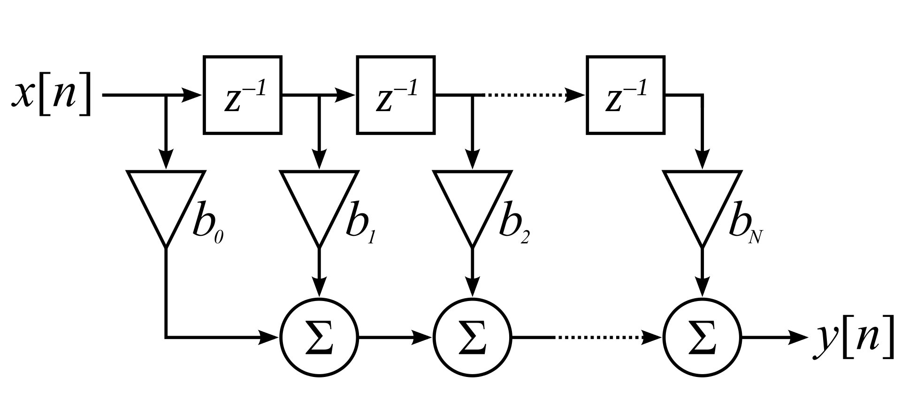
FIR filter design for PIC family
FIR Filter block diagram is shown below:

Slide 60
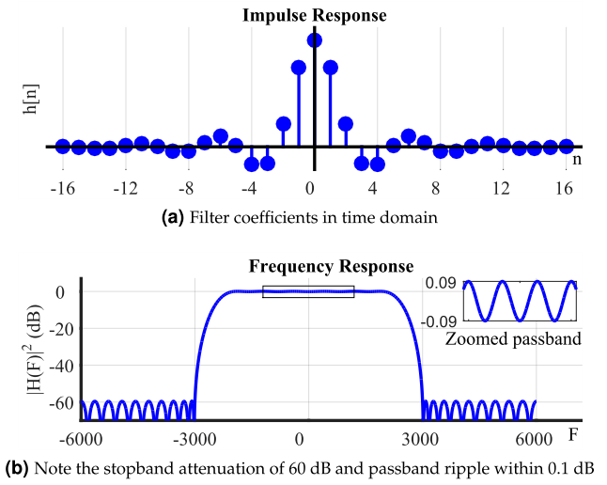
FIR filter design for PIC family
FIR Filter impulse response and frequency response are shown below:

Slide 61
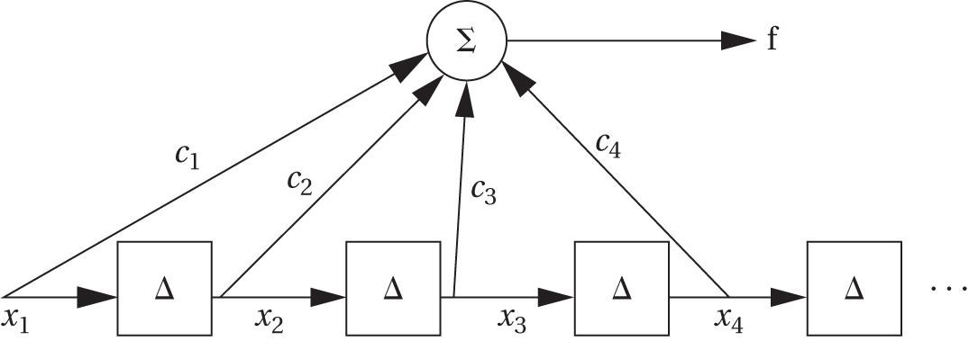
FIR filter design for PIC family
FIR Filter block diagram for PIC code is shown below:
= Σ c_{j}x_{j}
1< j <n

Slide 62
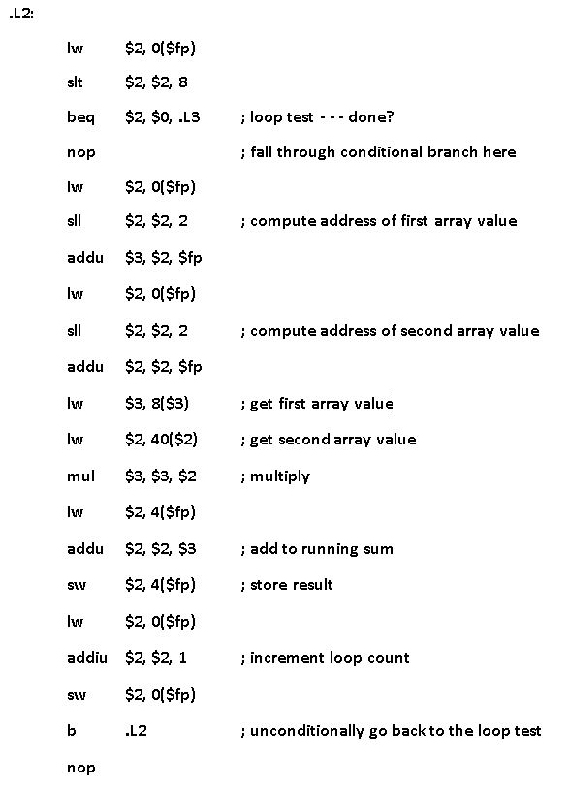
PIC32 microprocessor family
FIR Filter assembly language code generated by PIC MPLAB C32 compiler for Microchip’s PIC32 microcontroller family with MIPS instruction set is shown here

Slide 63
ARM microprocessor family

Slide 64
ARM microprocessor family
There are many different types of ARM microprocessors von Neumann architecture
ARM7 processor has Von Neumann architecture
ARM Cortex-M3 processor has Harvard architecture
ARM processors are standard 32 bit long data processors
ARMv8 processors are 64-bit long data processors
ARM processors can have big-endian or little-endian word organization
ARM processor programming is usually done in high-level languages (e.g. C)
ARM processors have pretty sophisticated instruction sets

Slide 65
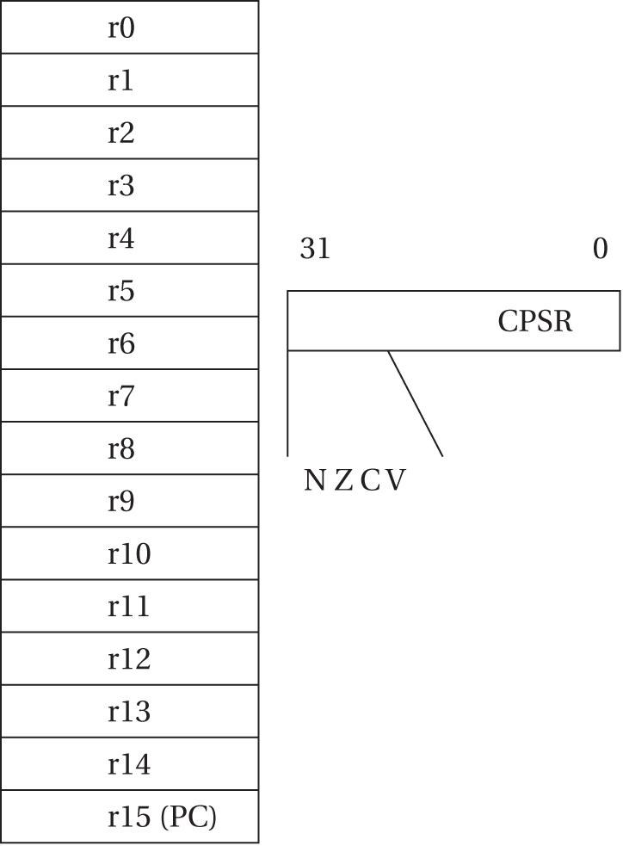
ARM microprocessor family
ARM is load-store architecture – data operands must first be loaded into the CPU and then stored back to main memory to save the results
The basic ARM programming model is shown below:

Slide 66
ARM microprocessor family
ARM is load-store architecture – data operands must first be loaded into the CPU and then stored back to main memory to save the results
The basic ARM programming model is shown below:
16 general purpose 32-bits registers

Slide 67
ARM microprocessor family
ARM is load-store architecture – data operands must first be loaded into the CPU and then stored back to main memory to save the results
The basic ARM programming model is shown below:
Current program status register (CPSR) - set during any arithmetic, logical or shifting operation
16 general purpose 32-bits registers

Slide 68
ARM microprocessor family
ARM is load-store architecture – data operands must first be loaded into the CPU and then stored back to main memory to save the results
The basic ARM programming model is shown below:
Current program status register (CPSR) - set during any arithmetic, logical or shifting operation
16 general purpose 32-bits registers
The negative bit (N) is set when the result is negative in two’s-complement arithmetic

Slide 69
ARM microprocessor family
ARM is load-store architecture – data operands must first be loaded into the CPU and then stored back to main memory to save the results
The basic ARM programming model is shown below:
Current program status register (CPSR) - set during any arithmetic, logical or shifting operation
16 general purpose 32-bits registers
The zero bit (Z) is set when every bit of the result is zero

Slide 70
ARM microprocessor family
ARM is load-store architecture – data operands must first be loaded into the CPU and then stored back to main memory to save the results
The basic ARM programming model is shown below:
Current program status register (CPSR) - set during any arithmetic, logical or shifting operation
16 general purpose 32-bits registers
The carry bit (C) is set when there is a carry out of the operation

Slide 71
ARM microprocessor family
ARM is load-store architecture – data operands must first be loaded into the CPU and then stored back to main memory to save the results
The basic ARM programming model is shown below:
Current program status register (CPSR) - set during any arithmetic, logical or shifting operation
16 general purpose 32-bits registers
The overflow bit (V) is set when an arithmetic operation results in an overflow

Slide 72
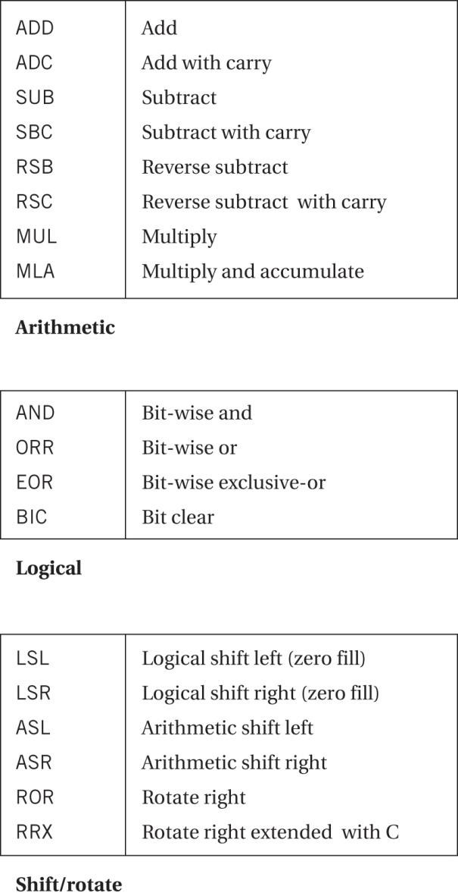
ARM microprocessor family
ARM data instructions are shown below:

Slide 73
ARM microprocessor family
ARM data instructions are shown below:
ADD r0, r1, #2 ; r0 = r1+2

Slide 74
ARM microprocessor family
ARM data instructions are shown below:
RSB r0, r1, r2 ; r0 = r2 – r1

Slide 75
ARM microprocessor family
ARM data instructions are shown below:
MLA r0, r1, r2, r3 ; r0 = r1 x r2 + r3

Slide 76
ARM microprocessor family
ARM data instructions are shown below:
BIC r0, r1, r2 ; r0 = r1 and
; r0 = r2

Slide 77
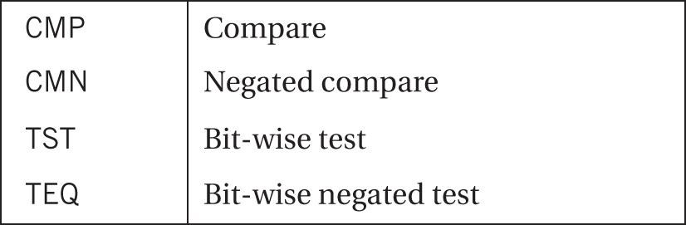
ARM microprocessor family
ARM compare instructions are shown below:

Slide 78
ARM microprocessor family
ARM compare instructions are shown below:
CMP r0, r1 ; r0 = r0 – r1 and sets the status bits
; and throws away the results of subtraction

Slide 79
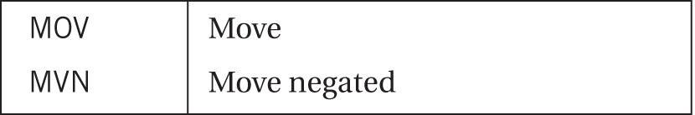
ARM microprocessor family
ARM move instructions are shown below:

Slide 80
ARM microprocessor family
ARM move instructions are shown below:
MOV r0, r1 ; r0 = r1

Slide 81
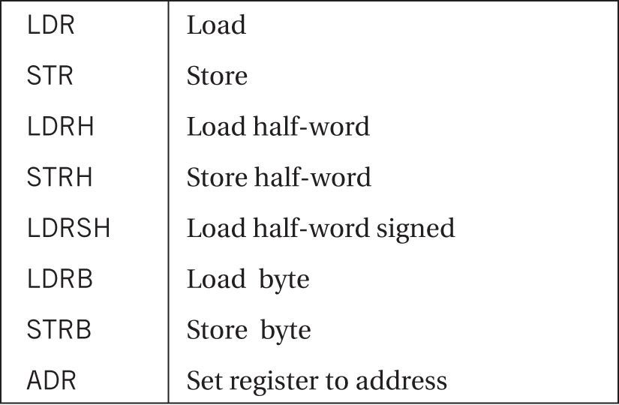
ARM microprocessor family
ARM load-store instructions are shown below:

Slide 82
ARM microprocessor family
ARM load-store instructions are shown below:
LDR r0, [r1]
; loads r0 from ; the address ; given by r1

Slide 83
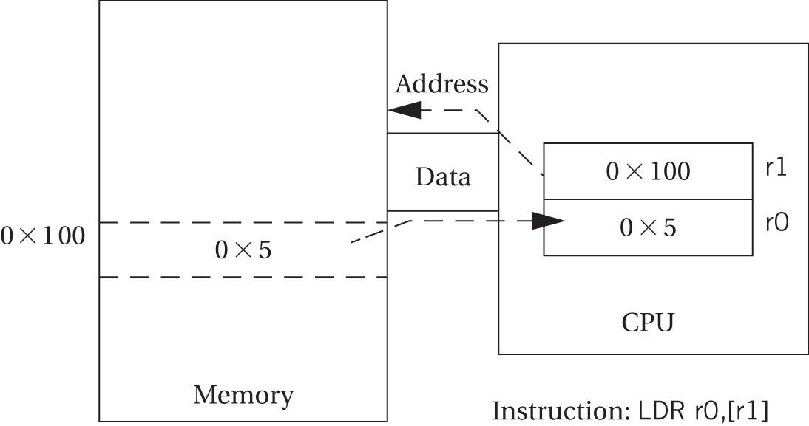
ARM microprocessor family
Register indirect addressing in the ARM is shown below:

Slide 84
ARM microprocessor family
ARM load-store instructions are shown below:
LDR r0, [r1, -r2]
; loads r0 from ; the address ; given by r1-r2

Slide 85
ARM microprocessor family
ARM load-store instructions are shown below:
LDR r0, [r1, #4]
; loads r0 from ; the address ; given by r1+4

Slide 86
ARM microprocessor family
ARM load-store instructions are shown below:
STR r0, [r1]
; stores value ; from r0 in ; memory ; location ; whose ; address ; is given in r1

Slide 87
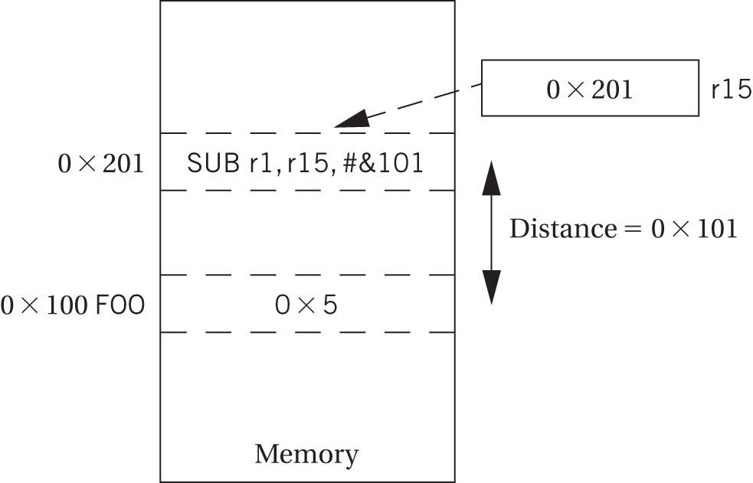
ARM microprocessor family
Computing an absolute address using the PC in is shown below:

Slide 88
ARM microprocessor family
Examples:
C statement: x = ( a + b ) - c;
ldr r2, [fp, # -24]
ldr r3, [fp, # -28]
add r2, r2, r3
ldr r3, [fp, # -32]
rsb r3, r3, r2
str r3, [fp, # -36]
(2) C statement: y = a*( b + c);
ldr r2, [fp, # -28]
ldr r3, [fp, # -32]
add r2, r2, r3
ldr r3, [fp, # -24]
mul r3, r2, r3
str r3, [fp, # -40]

Slide 89
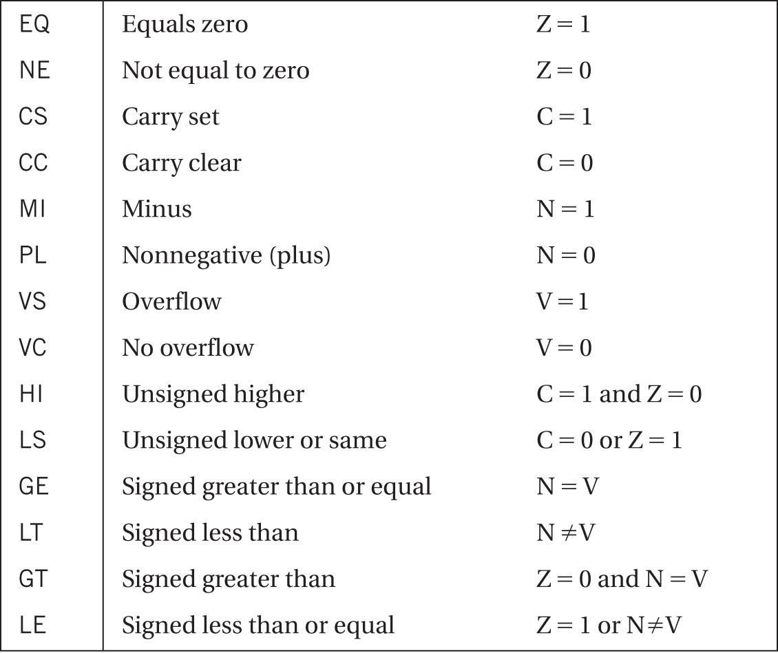
ARM microprocessor family
Condition codes in ARM are shown below:

Slide 90
ARM microprocessor family
Example:
C statement:
if (a > b) {
x = 5;
y = c+d;
}
else x = c – d;
Assembler:
ldr r2, [fp, # -24]
ldr r3, [fp, # -28]
cmp r2, r3
ble .L3
.L2: mov r3, #5
str r3, [fp, # -40]
ldr r2, [fp, # -32]
ldr r3, [fp, # -36]
add r3, r2, r3
str r3, [fp, # -44]
b .L3
ldr r3, [fp, # -32]
ldr r2, [fp, # -36]
rsb r3, r2, r3
str r3, [fp, # -40]
.L3:

Slide 91
ARM microprocessor family
Example:
C statement:
if (a > b) {
x = 5;
y = c+d;
}
else x = c – d;
Assembler:
ldr r2, [fp, # -24]
ldr r3, [fp, # -28]
cmp r2, r3
ble .L3
.L2: mov r3, #5
str r3, [fp, # -40]
ldr r2, [fp, # -32]
ldr r3, [fp, # -36]
add r3, r2, r3
str r3, [fp, # -44]
b .L3
ldr r3, [fp, # -32]
ldr r2, [fp, # -36]
rsb r3, r2, r3
str r3, [fp, # -40]
.L3:
jump to .L3 if a <= b

Slide 92
ARM microprocessor family
An FIR Filter assembly language code generated for the ARM processor and C language code equivalent
.LBB2:
mov r3, #0
str r3, [fp, # -24]
mov r3, #0
str r3, [fp, # -28]
.L2:
ldr r3, [fp, # -24]
cmp r3, #7
ble .L5
b .L3
.L5:
ldr r3, [fp, # -24]
mvn r2, #47
mov r3, r3, asl #2
sub r0, fp, #12
add r3, r3, r0
add r1, r3, r2
ldr r3, [fp, # -24]
mvn r2, #79
mov r3, r3, asl #2
sub r0, fp, #12
add r3, r3, r0
add r3, r3, r2
ldr r2, [r1, #0]
ldr r3, [r3, #0]
mul r2, r3, r2
ldr r3, [fp, # -28]
add r3, r3, r2
str r3, [fp, # -28]
ldr r3, [fp, # -24]
add r3, r3, #1
str r3, [fp, # -24]
b .L2
.L3:
for ( i = 0, f = 0, i < N; i++)
f = f + c[ i ]*x[ i ];

Slide 93
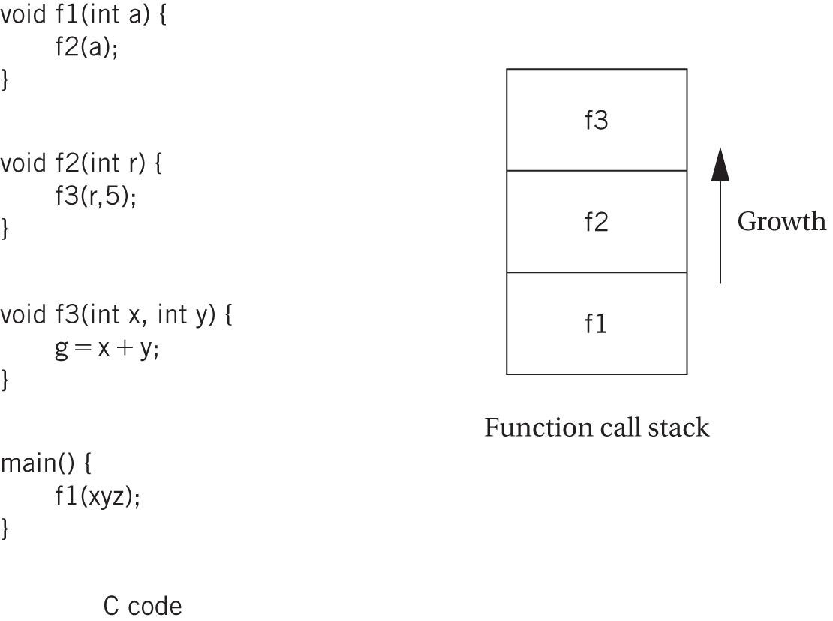
ARM microprocessor family
Nested function calls and stacks are shown below:
Example 2.6 in textbook (page 76) shows how to apply procedure calls using ARM Instruction Set

Slide 94
ARM microprocessor family
Advanced ARM features:
  SIMD – multimedia operations supported by single-instructions multiple-data (SIMD) operations
  NEON – expanded SIMD instructions with additional registers and additional operations
  TrustZone – Adds security features
  Jazelle – These instructions allow direct execution of 8-bit Java bytecodes (bytecode interpreter does not need to be used to execute Java programs)
  Cortex – ARM family of processors that includes:
    Cortex-5 – Jazelle execution of Java, floating-point processing, NEON multimedia instructions
    Cortex-A8 – superscalar processor
    Cortex-A9 – multiprocessor with up to 4 cores
    Cortex-A15 – MPCore multiprocessor with up to 4 cores
    Cortex-R – SIMD operations for DSP
    Cortex-M – microcontroller type of systems with low cost and low energy requirements

Slide 95
Texas Instrument’s C55x microprocessor DSP family

Slide 96
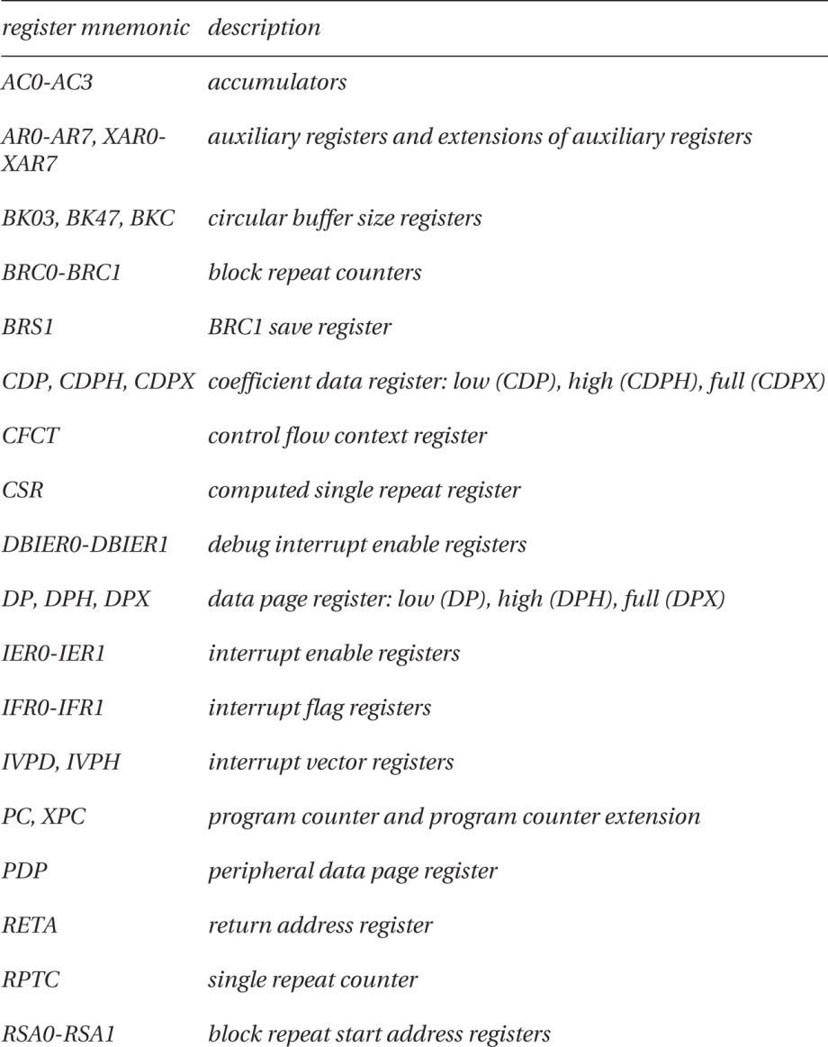
C55x microprocessor DSP family
Texas Instruments C55x registers are shown below:

Slide 97
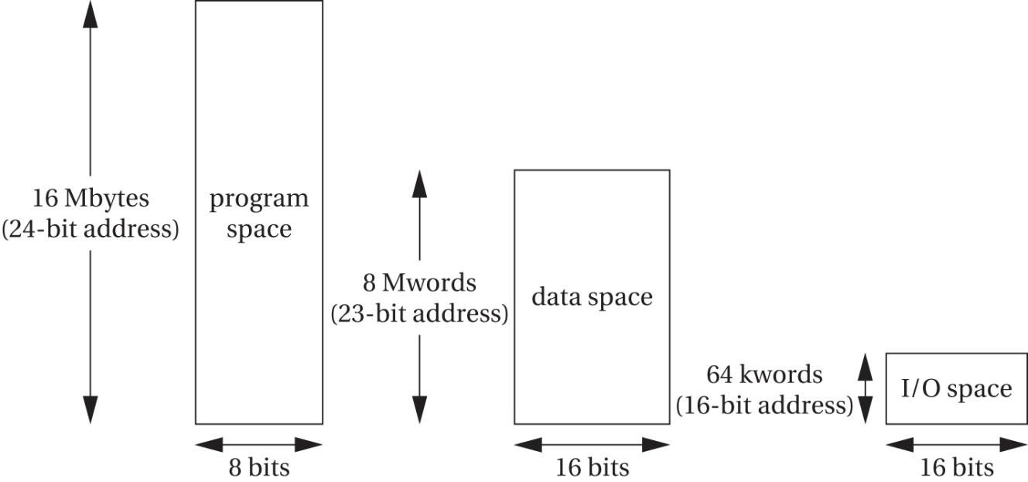
C55x microprocessor DSP family
C55x supports a 24-bit address space providing 16MB of memory on chip
Address spaces (program, data and I/O) in the TMS320CD55x are all mapped to the same physical memory and they are shown below:

Slide 98
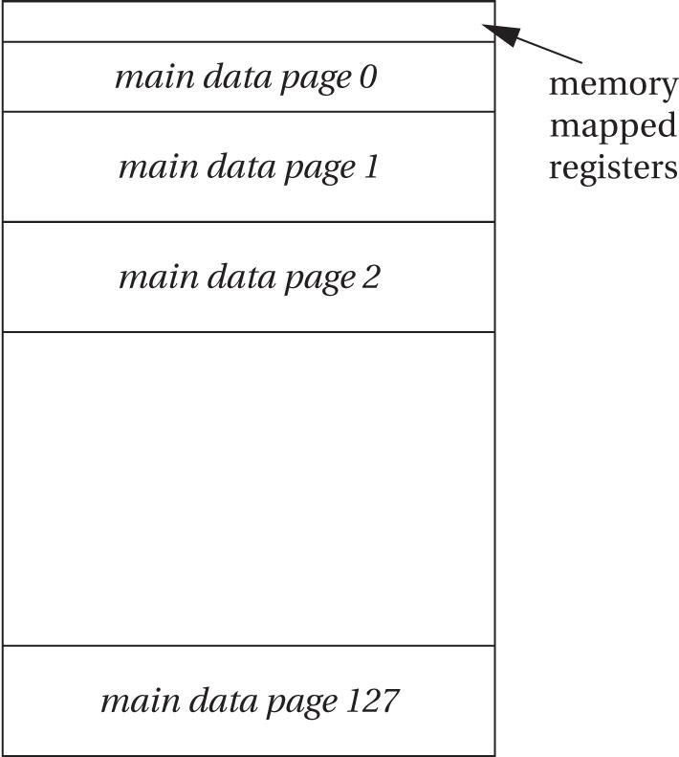
C55x microprocessor DSP family
The C55x memory map is shown below:
Data memory
space

Slide 99
C55x microprocessor DSP family
FIR filter example on the C55x is shown here
MOV AR0, *SP(#1) ; set up the loop
MOV T0, *SP(#0)
MOV #0, *SP(#2)
MOV #0, *SP(#3)
MOV *SP(#2), AR1
II MOV #8, AR2
CMP AR1 >= AR2, TC1
II NOP ; avoids Silicon Exception CPU_24
BCC $C$L2, TC1
; loop body
$C$L1:
$C$DW$L$_main$2$B:
MOV SP, AR3 ; copy stack pointer into auxiliary ; registers for address computation
MOV SP, AR2
MOV AR1, T0
AMAR *+AR3(#12) ; set up operands
ADD *SP(#2), AR3, AR3
MOV *SP(#3), AC0 ; put f into auxiliary register
AMAR *+AR2(#4)
MACM *AR3, *AR2(T0), AC0, AC0 ; multiply and accumulate
MOV AC0, *SP(#3) ; save f on stack
ADD #1, SP(#2) ; increment loop count
MOV *SP(#2), AR1
II MOV #8, AR2,
CMP AR1 <AR2, TC1
II NOP ; avoids Silicon Exception CPU_24
BCC $C$L1, TC1
; return for next iteration

Slide 100
Texas Instrument’s C64x microprocessor DSP family

Slide 101
C64x microprocessor DSP family
High-performance VLIW DSP
C64x can execute up to 8 instructions per cycle
C64x provides both fixed-point and floating-point arithmetic
C64x is load/store architecture
Instructions are performed by 2 data paths A and B
Each data path provides four function units for various operations:
  .L units
  .S units
  .M units
  .D units
Each data path provides four function units for data movement:
  .LD units
  .ST units
  .DA units
  .X units
The C64x organizes instructions into execution packets to enable parallel execution

Slide 102
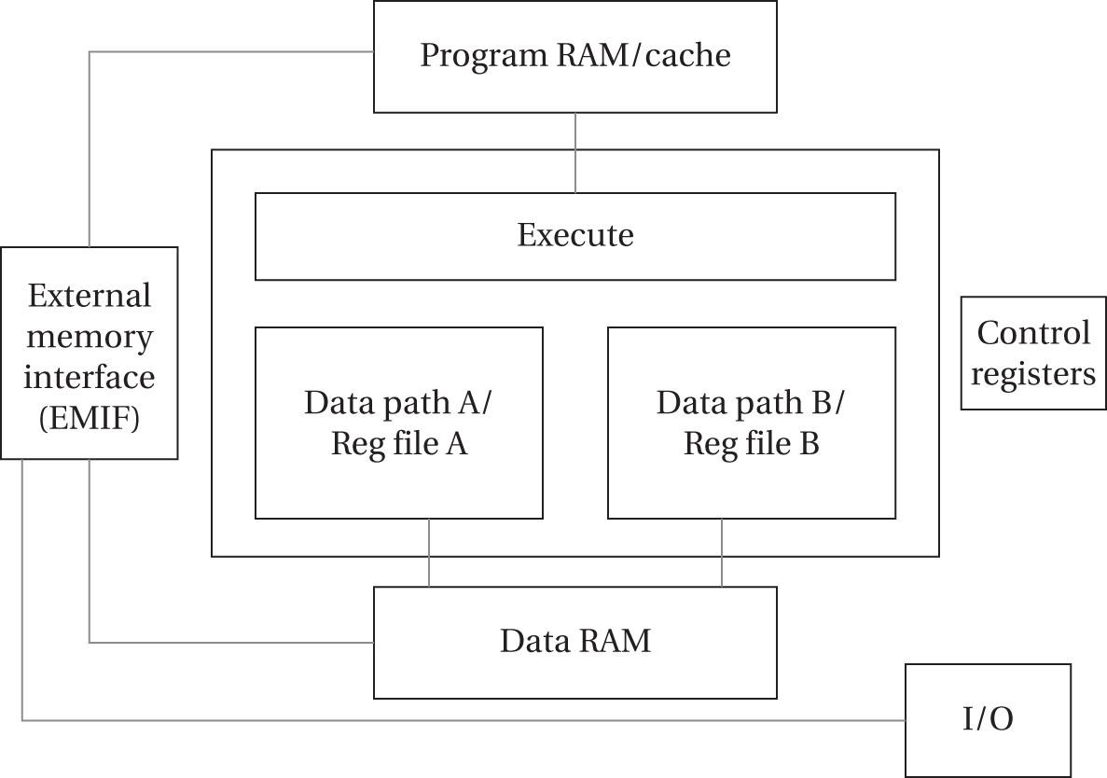
C64x microprocessor DSP family
High-performance VLIW DSP
C64x block diagram is shown below:

